Slide 1


YouTube
Song Analysis
presented by Abdullateef Adebiyi
Trends and factors

Slide 2

Introduction
Data analysis on YouTube song videos offers numerous benefits, enabling content creators to make informed decisions, optimize operations, and enhance viewer engagement. In this case Power BI, a business analytic tool is used to transformed YouTube Song data into actionable insights enhance making informed decisions.

Slide 3


Aim
The goal of this analysis is to utilize Power BI to create insightful visualizations and reports that provide a deeper understanding of YouTube songs' performance, popularity, and user engagement. The analysis aims to uncover trends, preferences, and patterns in the data to aid content creators and stakeholders in optimizing their YouTube song content.

Slide 4

01.
Objectives
Data Cleaning and Preparation:
Clean and preprocess the dataset, handling missing values or outliers.
Convert relevant columns to appropriate data types.
Exploratory Data Analysis (EDA):
Explore patterns and distributions in view counts, like counts, and comments.
Identify trends in the popularity and engagement of YouTube song videos.
Content and Channel Analysis:
Analyze the distribution of videos across different channels.
Identify popular tags and their correlation with view
counts.
Temporal Trends:
Explore how YouTube song video metrics vary over time.
Identify peak publishing times and their impact on
engagement.
User Engagement Insights:
Investigate relationships between likes, comments, and views.
Identify factors influencing user engagement with YouTube song videos.
02.
03.
04.
05.

Slide 5
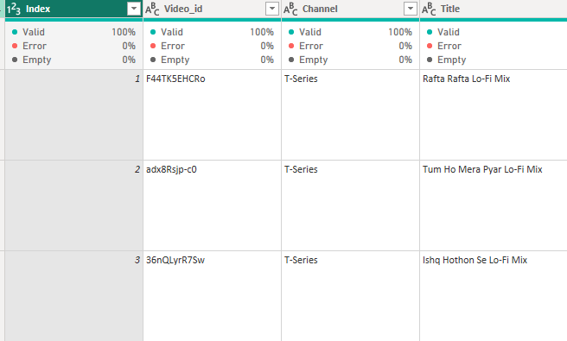
Steps taken in the analysis
The first step taken in the analysis of this data is data cleaning.
After loading the data, it was transformed to Powsr
❹usry to remove duplicates to ensure unique record details. Further transform to the appropriate data types, remove and replace null values, remove unnecessary columns, and rename columns.
Calculated columns and conditional columns were also
created before loading back to Powsr BI where
measures were created for visualization and further analysis.

Slide 6
Dataset Description
video_id: Unique identifier for each YouTube video.
channelTitle: Title of the YouTube channel publishing the song.
title: Title of the YouTube song video.
description: Description provided for the YouTube song video.
tags: Tags associated with the YouTube song video.
publishedAt: Date and time when the YouTube song video was published.
viewCount: Number of views received by the YouTube song video.
likeCount: Number of likes received by the YouTube song video.
favoriteCount: Number of times the YouTube song video has been marked as a favorite.
commentCount: Number of comments posted on the YouTube song video.
duration: Duration of the YouTube song video.
definition: Video definition or quality (e.g., HD, SD).
caption: Availability of captions for the YouTube song video.

Slide 7
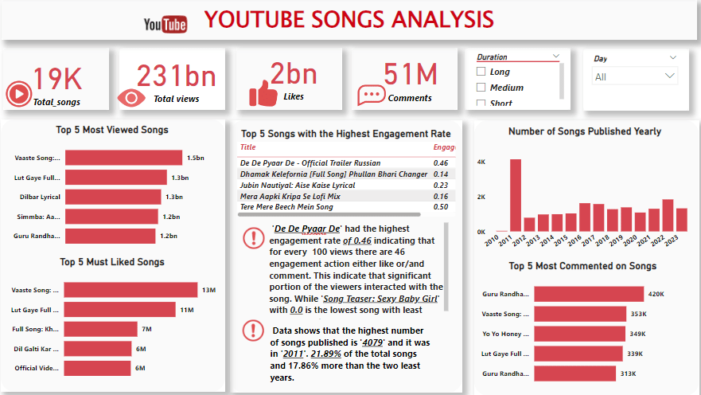

Slide 8
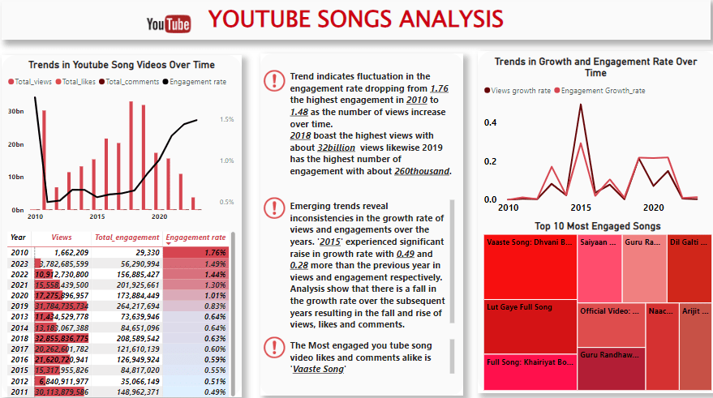

Slide 9
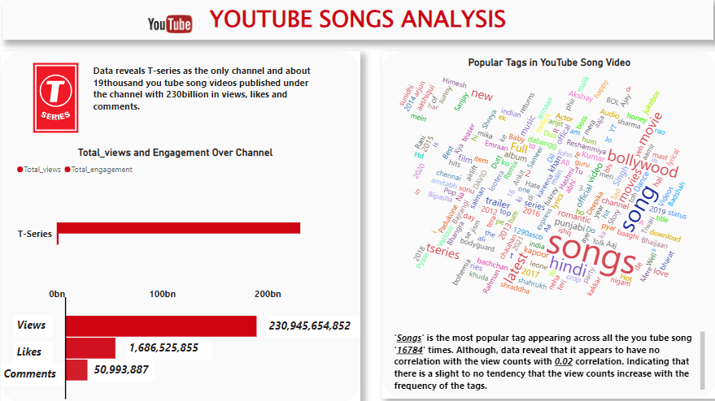

Slide 10
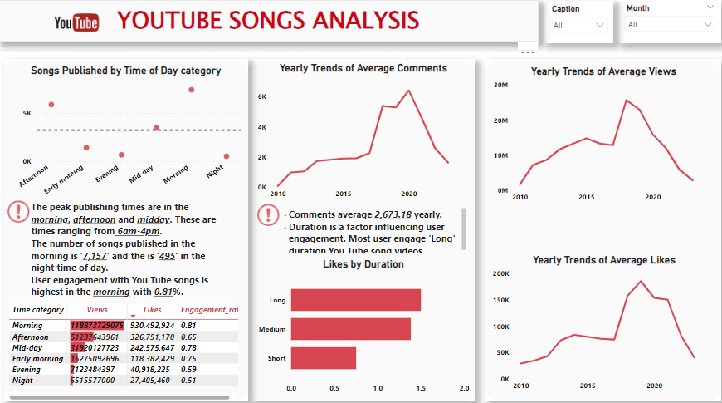

Slide 11
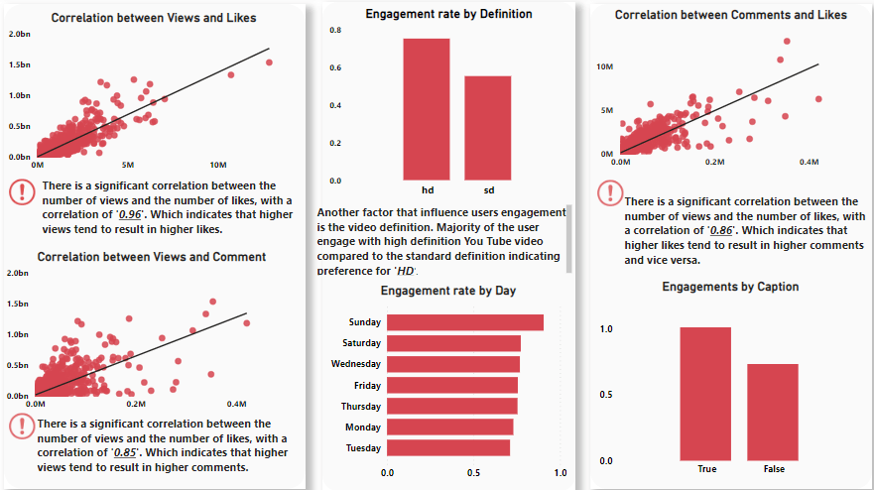

Slide 12

Actionable Insights
Highest Engagement and Viewer Interaction
De De Pyaar Dehad the highest engagement rate of
0.46 with 46 engagement actions (likes and
comments) for every 100 views. This indicates that a significant portion of the viewers interacted with the song.
The Song Teaser: Sexy Baby Girl had the lowest engagement rate 0.0, indicating minimal viewer interaction likely due to lack of appeal or interest.
The highest number of songs published was 4,0/9 in 2011, accounting for 21.89% of the total songs, 1/.86% more than the two least prolific years.
Engagement rates fluctuate over the years, with the highest rate at 1./6 in 2010, dropping to 1.48 as the number of views increased over time.

Slide 13
Popularity and Engagement Trends
2018 recorded the highest number of views, with approximately 32 billion views indicating a surge in user interest or effective marketing.
2019 had the highest number of engagements, with about 260,000 likes and comments reflecting active viewer participation.
There have been inconsistencies in the growth rate of views and engagements over the years. Notably, 2015 experienced a significant growth rate with increases of 0.49 in views and 0.28 in engagement from the previous year. However, subsequent years saw fluctuating growth rates in views, likes, and comments possibly due to varying content quality and audience preferences.
Vaaste Song: This song video had the highest number of likes and comments, making it the most engaged YouTube song video.
2018 had the highest average number of views per video, reaching an average of 25,/08,/92.4/ views, a 99./0% increase from the previous year and more than double the average views in 2023. High-definition videos averaged 25,809,4/9./4 views.
In 2019, T-Series experienced the highest average number of likes per video, reaching 185,/54.51 likes, influenced by high-definition and short-duration
videos. All users engaged with HD videos, while the majority liked short-duration videos.
Channel Insights
T-Series: This is the only channel with about 19,000 YouTube song videos published, amassing 230 billion views, likes, and comments. Popular Tags and Publishing Times
"Songs" is the most frequently used tag, appearing 16,/84 times. However, it has a very low correlation (0.02) with view counts, indicating a slight to no
increase in views with the frequency of this tag suggesting tags alone don’t drive views.
The peak times for publishing are in the Morning, Afternoon, and Mid-day (6 AM - 4 PM). The morning has the highest number of songs published (7,157),
while night-time has the least (495) possibly due to release strategy and industry practices.
User engagement with YouTube songs is highest in the morning at 0.81%. Possibly due to higher viewer availability. Relationship between video metrics and Engagement Factors
The average number of comments per year is 2,6/3.18.
Long-duration YouTube song videos receive the most user engagement likely because Informative and entertaining content can keep viewers engaged for longer periods and encourage them to share their insights or ask questions..
There is a significant correlation (0.96) between the number of views and likes, indicating that higher views tend to result in higher likes. Similarly, there is a strong correlation (0.85) between views and comments.
Users prefer high-definition (HD) videos over standard definition, indicating a higher engagement with HD videos.
There is also a significant correlation (0.86) between likes and comments, suggesting that higher likes tend to result in higher comments and vice versa.
Weekend Engagement: Engagement rates are higher during weekends, particularly on Sundays, with the highest engagement rate at 0.91% possibly due to more leisure time.
Morning Releases: Songs released in the morning receive 0.81% engagement, which is 58.82% more than songs released at night, the least popular
publishing time likely due to increased daytime activity like listening to songs during commutes.

Slide 14
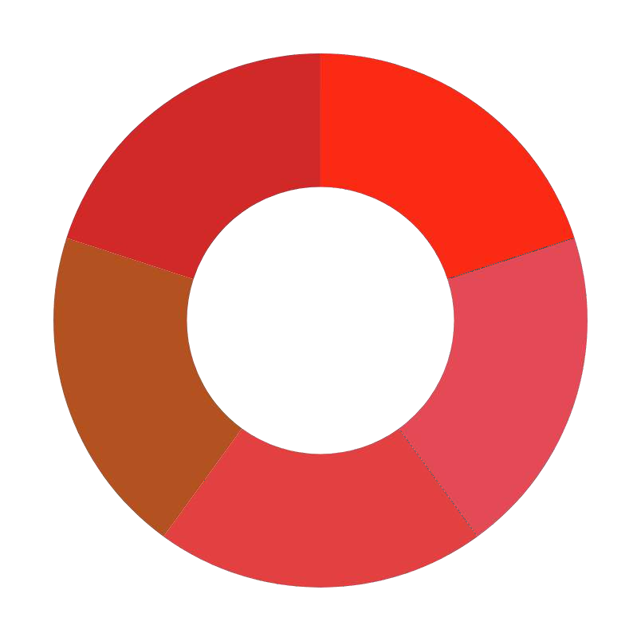
Recommendation
Stakeholders and content creators should ensure videos released are in high-definition (HD) as they attract more engagement.
Focusing on releasing song videos or content in the early hours (morning), to capitalize on higher viewer engagement and minimize night-time releases, as they have the least engagement.
Ensure videos are in HD, as they attract more engagement. Viewers show a clear preference for better quality.
Since long-duration videos drive higher engagement, aim
for impactful content that retains viewer attention.
Creators should use a mix of trending and relevant tags together with captivating captions to increase
discoverability without over-relying on generic tags like "Songs."
Stakeholders should plan major releases for weekends to
benefit from higher engagement rates
Create content that encourages community interaction, such as QsA sessions, live streams, and comment shout- outs this way the engagement rate can be increased.

Slide 15


presented by Abdullateef Adebiyi
Thank you for listening!

